Slide 1
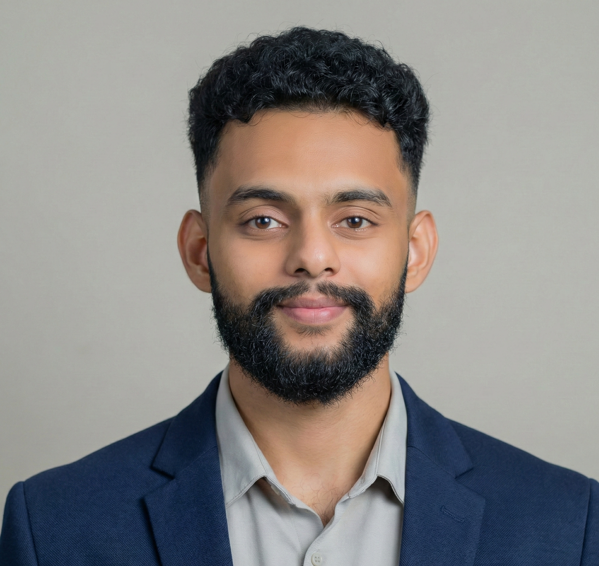

Girish Naik
GEN AI ENGINEER
FTE
RELEVANT EXPERIENCE
As a Gen AI Engineer, I have
Engineered and deployed Agentic AI workflows using frameworks like LangGraph and LangChain, moving beyond static RAG to build autonomous agents capable of dynamic reasoning and tool-use.
Developed and optimized production-grade RAG systems, integrating vector databases (ChromaDB) and custom retrieval logic to reduce latency and improve information accuracy for enterprise-scale datasets.
Architected and fine-tuned LLMs and Vision Language Models (VLM), including training a Transformer model from scratch using PyTorch and implementing LoRA fine-tuning for specialized domain tasks.
Designed scalable AI orchestration layers using FastAPI and asynchronous processing to handle high-concurrency environments.
Implemented advanced Prompt Engineering and Guardrail strategies to ensure healthcare and financial compliance, automating document digitization and reducing manual inventory tracking by 58%..
Integrated diverse AI stacks and ecosystems, leveraging tools like Ollama, Groq, and N8N to bridge the gap between experimental
+91 95035-06624
gsateeshnaik@deloitte.com
Pune, India
RELEVANT SKILLS
Girish has 3.5+ years of experience as a Gen AI and Machine Learning Engineer. Proficient in Agentic AI (LangGraph, LangChain), Python, PyTorch, and AWS. Skilled in architecting and deploying autonomous AI Agents and high-scale RAG systems, with hands-on experience in building full-stack AI applications using FastAPI and Streamlit. Proven ability to deliver high-impact solutions while leveraging deep technical expertise in LLMs, Computer Vision (YOLOv8), and scalable MLOps environments.
Languages & AI Core : Python, SQL, LLMs (OpenAI, Anthropic, Ollama), Deep Learning, NLP
Frameworks & AI Orchestration : LangGraph, LangChain, FastAPI, PyTorch, NumPy, Scikit-learn, Keras, Pandas, Matplotlib, HuggingFace, Streamlit
Database & Data : PostgreSQL, DataBricks, RDBMS, ETL
DevOps & Infrastructure : AWS, Docker, K8ns, CI/CD
Tools & Collaboration :N8N, MCP, MLFlow, Git, Linux, VS Code
EDUCATION/CERTIFICATIONS
SYMBIOSIS SKILLS AND PROFESSIONAL UNIVERSITY, India, Bachelor of Technology : Mechatronics

